Slide 1
Testing

Slide 2

Topics
Unit testing
White Box testing
Black Box testing

Slide 3
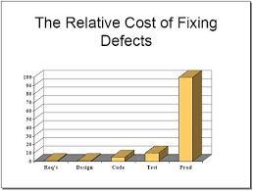
Unit Testing

Slide 4

Unit Testing (1)
Unit testing
Is a software testing methodology used to determine if a “unit” is ready for use
Each test verifies the behavior of one unit
Ignoring all collaborations with other units

Slide 5
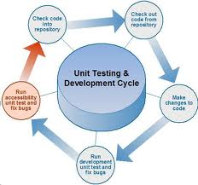
Unit Testing (2)
In procedural programming, a unit could be an entire module, but it is more commonly an individual function or procedure
In object-oriented programming, a unit is often an entire interface, such as a class, but could be an individual method

Slide 6
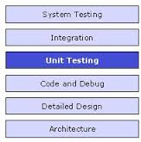
Unit Testing (3)
It forms the basis for component testing or integration
Ideally, each test case is independent from the others
Substitutes such as method stubs, mock objects, fakes, and test harnesses can be used to assist testing a module in isolation
Unit tests are typically written and run by software developers to ensure that code meets its design and behaves as intended

Slide 7
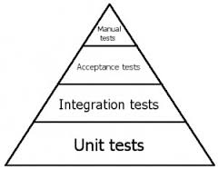
Unit Testing (4)
The goal of unit testing is to isolate each part of the program and show that the individual parts are correct
A unit test provides a strict, written requirement that the piece of code must satisfy

Slide 8

Integration and System Testing
Integration tests
Tests that verifies the unit collaborations
System tests
Tests that verifies system's behavior
Integration and system tests are typically written and run by software testers (not software developers) to ensure that code meets its design and behaves as intended

Slide 9
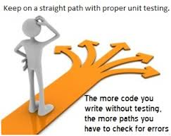
Benefits of Unit Testing (1)
Finds problems early in the development cycle
Test cases are written for all methods so that whenever a change causes a fault, it can be quickly identified
Unit tests detect changes which may break a requirement

Slide 10

Benefits of Unit Testing (2)
Simplifies integration
By testing the parts of a program first and then testing the sum of its parts, integration testing becomes much easier
Documentation
Unit testing provides a sort of living documentation of the system
Developers looking to learn what functionality is provided by a unit, and how to use it

Slide 11

Regression Testing
A set of unit tests called regression tests are normally run nightly to continually verify that the software runs correctly (Continuous integration)

Slide 12

Unit Testing Limitations (1)
Unit testing will not catch every error in the program, since it cannot evaluate every execution path
Additionally, unit testing by definition only tests the functionality of the units themselves
It will not catch integration errors or broader system-level errors (such as functions performed across multiple units, or non-functional test areas such as performance)

Slide 13
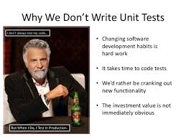
Unit Testing Limitations (2)
Software testing is a combinatorial problem
For example, every Boolean decision statement requires at least two tests: one with an outcome of "true" and one with an outcome of "false“
As a result, for every line of code written, programmers often need 3 to 5 lines of test code

Slide 14

Unit Testing Frameworks (1)
CPPUNIT - Released under LGPL (license under the GNU public license)
Google C++ Mocking Framework
GoogleTest
CUTE – Integrated with Eclipse
Single line include, without inheritance
TestComplete - SmartBear

Slide 15
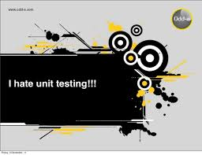
Unit Testing Frameworks (2)
It is generally possible to perform unit testing without the support of a specific framework by writing client code that exercises the units under test and uses assertions, exception handling, or other control flow mechanisms to signal failure

Slide 16
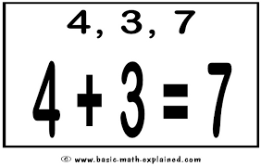
Test Case Example
Testing a simple method that adds two numbers
Possible checks
Positive + Positive
Zero + Zero
Positive + Zero
Negative + Zero
Positive + Negative
Negative + Positive
Negative + Negative
Large numbers
Small numbers
See testing1.cpp thru testing2.cpp

Slide 17

More Test Case Examples
See testing3.cpp thru testing4.cpp
These two test cases, build a test suite, that is: a collection of test cases which test the same unit

Slide 18

Test Case Development
All test cases and test suites should be developed while coding the units
Every time the unit changes, corresponding unit test should reflect changes
Modifying a test case or adding new one
For instance, if one improves the "addition" module to add decimal numbers, one will have to change the tests, adding for example a new addDecimalNumbersTest test case
The set of test suites make up the regression testing suite

Slide 19

Test Case Example Using Assert
Testing a simple method that adds two numbers using classes and the assert macro
See testing5.cpp

Slide 20
White Box Testing

Slide 21
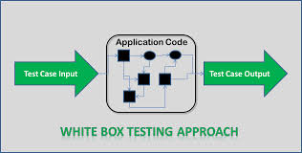
White Box Testing
White-box testing is a method of testing software that tests internal structures or workings of an application, as opposed to its functionality (i.e. black-box testing)
In white-box testing an internal perspective of the system, as well as programming skills, are used to design test cases
The tester chooses inputs to exercise paths through the code and determine the appropriate outputs

Slide 22
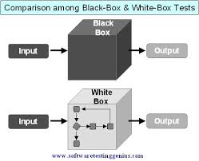
White Box vs Black Box Testing
White-box uses the source code to derived the tests
Black-box uses the source code requirements

Slide 23
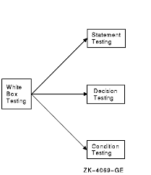
White Box Testing (2)
White-box testing can be applied at the unit, integration and system levels of the software testing process
It can test paths within a unit, paths between units during integration, and between subsystems during a system–level test
Though this method of test design can uncover many errors or problems, it has the potential to miss unimplemented parts of the specification or missing requirements

Slide 24
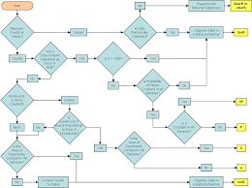
White Box Test Design Techniques
Includes the following code coverage criteria:
Control flow testing
Data flow testing
Branch testing
Statement coverage
Decision coverage
Modified condition/decision coverage
Path testing

Slide 25

White Box Unit Testing
White-box testing is done during unit testing to ensure that the code is working as intended, before any integration happens with previously tested code
White-box testing during unit testing catches any defects early on and aids in any defects that happen later on after the code is integrated with the rest of the application

Slide 26
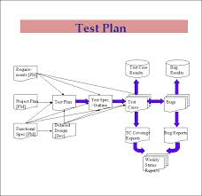
White Box Test Procedure (1)
The preparation stage of white-box testing to layout all of the basic information
Reviewing requirements, functional specifications, detailed designing of documents, proper source code, security specifications
Building test cases phase to make sure they thoroughly test the application
Performing risk analysis
Developing proper test plan, executing test cases and communicating results

Slide 27

White Box Test Procedure
Output phase that involves preparing the final report that encompasses all of the above preparations and results

Slide 28
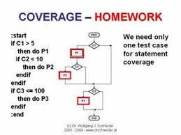
White Box Test Requirement
The programmer must have a deep understanding of the application to know what kinds of test cases are needed

Slide 29
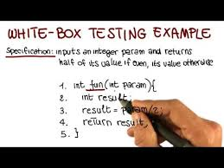
Advantages of White Box Testing (1)
Side effects of having the knowledge of the source code is beneficial thorough testing
Optimization of code by revealing hidden errors and being able to remove these possible defects
Gives the programmer introspection because developers carefully describe any new implementation

Slide 30
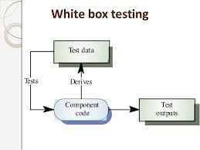
Advantages of White Box Testing (2)
Provides traceability of tests from the source, allowing future changes to the software to be easily captured in changes to the tests
White box tests are easy to automate
White box testing gives a clear, engineering-based, rules for when to stop testing

Slide 31
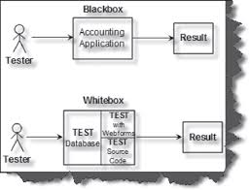
Disadvantages
White-box testing brings complexity to testing because the tester must have knowledge of the program, including being a programmer
White-box testing requires a programmer with a high-level of knowledge due to the complexity of the level of testing that needs to be done
On some occasions, it is not realistic to be able to test every single existing condition of the application and some conditions will be untested
The tests focus on the software as it exists, and missing functionality may not be discovered

Slide 32

White Box Hacking
White-box testing refers to a methodology where a white hat hacker has full knowledge of the system being attacked
The goal of a white-box penetration test is to simulate a malicious insider who has knowledge of and possibly basic credentials for the target system

Slide 33
Black Box Testing

Slide 34

Black Box Testing
Black-box testing is a method of software testing that examines the functionality of an application without peering into its internal structures or workings
This method of test can be applied to virtually every level of software testing: unit, integration, system and acceptance
It typically comprises most if not all higher level testing, but can also be used during unit testing as well

Slide 35
Black Box Test Procedures
The tester should be aware of what the software is supposed to do but is not aware of how it does it
For instance, the tester is aware that a particular input returns a certain, invariable output but is not aware of how the software produces the output in the first place
Knowledge of the application's code/internal structure and programming knowledge in general is not required

Slide 36
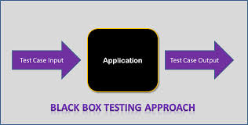
Black Box Test Cases
Test cases are built around specifications and requirements
What the application is supposed to do
Test cases are generally derived from external descriptions of the software, including specifications, requirement documents and design parameters
The test designer selects both valid and invalid inputs and determines the correct output, often with the help of a previous result that is known to be good, without any knowledge of the test object's internal structure

Slide 37
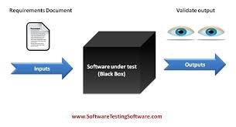
Black Box Test Design Techniques (1)
Decision table testing
Like flowcharts and if-then-else and switch-case statements, associate conditions with actions to perform
All-pairs testing
Is a combinatorial method of software testing that, for each pair of input parameters to a system (typically, a software algorithm), tests all possible discrete combinations of those parameters

Slide 38
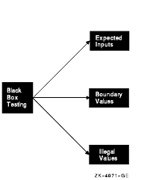
Black Box Test Design Techniques (2)
Equivalence partitioning
Divides the input data of a software unit into partitions of equivalent data from which test cases can be derived
In principle, test cases are designed to cover each partition at least once
This technique tries to define test cases that uncover classes of errors, thereby reducing the total number of test cases that must be developed

Slide 39
Black Box Test Design Techniques (3)
Boundary value analysis
Technique in which tests are designed to include representatives of boundary values in a range
Cause–effect graph
Maps a set of causes to a set of effects
The causes may be thought of as the input to the program, and the effects may be thought of as the output
Error guessing
Test method in which test cases used to find bugs are established based on experience in prior testing
The scope of test cases are based on the tester’s past experience and intuition

Slide 40

Black Box Hacking
Black-box testing refers to a methodology where an ethical hacker has no knowledge of the system being attacked
The goal of a black-box penetration test is to simulate an external hacking or cyber warfare attack

Slide 41

Test Plan

Slide 42
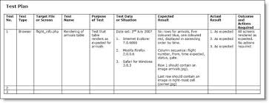
Test Plan
A software test plan is a document describing the testing scope and activities
It is the basis for formally testing any software
It describes the scope, approach, resources and schedule of intended test activities

Slide 43
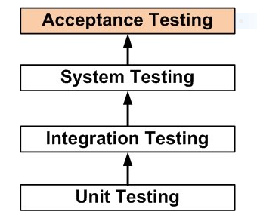
Master Test Plan
A single high-level test plan for a project/product that unifies all other test plans
The purpose of this test is to evaluate the system’s compliance with the business requirements and assess whether it is acceptable for delivery
Unit test plan (white or black)
Integration test plan (white or black)
System test plan (white or black)
Acceptance test plan (white or black)

Slide 44
Test Plan Detailed
It identifies the following
Test items
Features to be tested
Testing tasks
Who will do each task
Degree of tester independence
Test environment
The test design techniques and entry and exit criteria to be used
The rationale for their choice and any risks requiring contingency planning
It is a record of the test planning process

Slide 45
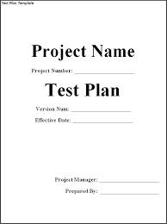
Test Plan Template (1)
Test plan id
Purpose of the test plan
Scope of the test plan
What will be tested
Documents that support the test plan
What features will be tested from a user’s perspective
What features will not be tested from a user’s perspective and what the system does

Slide 46

Test Plan Template (2)
Overall test strategy
Entry criteria
Conditions needed to start the testing
Exit criteria
When to stop testing
Suspension criteria
Conditions when to temporary stop testing
Roles and responsibilities of the test team
Schedule
When to testing will commence

Slide 47

Test Plan Template (3)
Necessary training needed for testing
Environment description
Hardware and software needed for testing
Test deliverables
Approval process
Glossary of terms

